Slide 1
Histological features of trachea and primary bronchus:
-Mucosa
-Sub mucosa
-Adventitia
_Mucosa: is composed of respiratory epithelium and lamina propria as layer of loose connective tissue (elastic and few reticular fiber, lymphatic tissue is found with serous and mucous glands).
_Sub mucosa: dense irregular connective tissue, c-shaped cartilage.
_Adventitia: dense fibro-connective tissue.

Slide 2
•Intrapulmonary bronchi:
(Secondary and tertiary bronchi)
-The primary bronchi are divided into secondary bronchi in the lung which is covered by thick elastic serous membrane (the plura) composed of two layers parietal and visceral.
-The internal structure of lung consists of branching system of bronchial tree.
•Secondary bronchus:
-The mucosa is composed of respiratory epithelium and lamina propria contains connective tissue, serous and mucous glands.

Slide 3
-Irregular plates of cartilage instead of c-shaped cartilage.
-smooth muscle layer as muscular is spirally arranged separated the lamina propria from sub mucosa, is rich with elastic fiber.

Slide 4
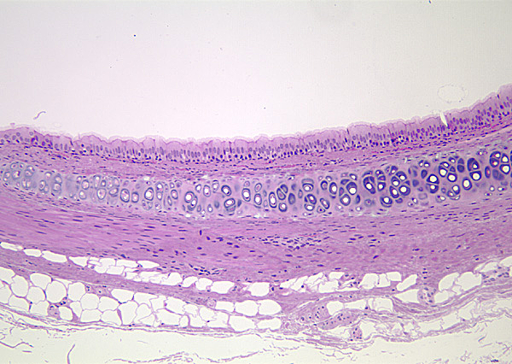
Trachea
Trachea –section – H&E – 10x objective
ciliated pseudostratified columnar epithelium
adventitia
submucosa
lumen
hyaline cartilage
adipose tissue

Slide 5
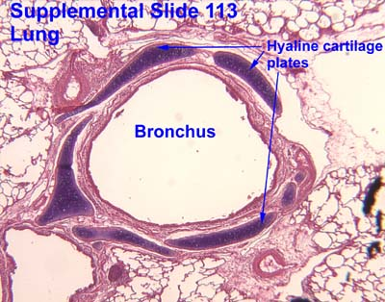

Slide 6
•Bronchioles:
-large bronchioles about 5mm or less in diameter.
-the wall is lined by respiratory epithelium, no glands, no cartilage.
-the epithelium becomes ciliated columnar with some goblet cells.
-bundle of smooth muscle is increased run in spiral manner.
1-Terminal bronchioles:
-Is distal part of bronchiole about 0.5 mm or less in diameter.
-the epithelium is columnar epithelium ciliated and some non-ciliated, have no goblet cells, Epithelium gradually become mostly Clara cells with cuboidal rather than ciliated epithelium as the terminal bronchioles near the respiratory bronchioles.

Slide 7
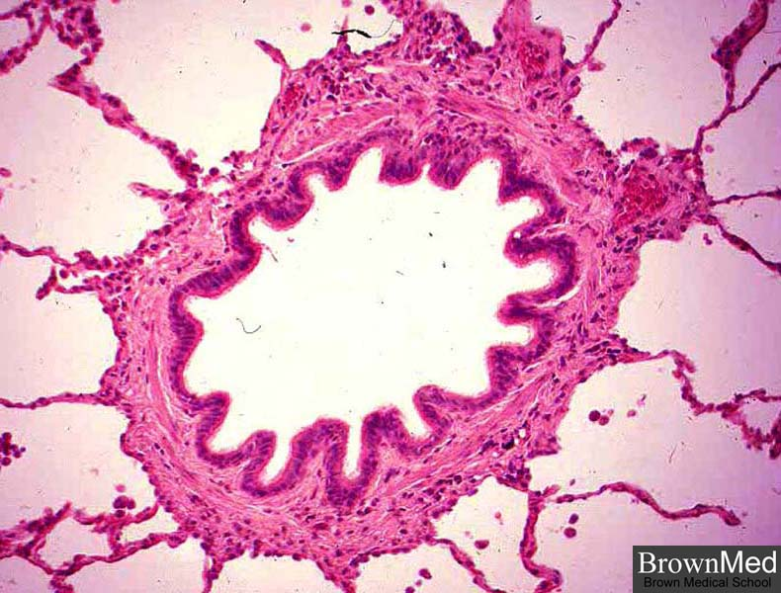
-Clara cells, secretory cell, dome-shaped, secret surfactants that decrease surface tension of fluid that moistens and protect the surface of the bronchiolar lining.
-lamina propria composed of elastic fiber, the smooth muscles, thick bundles one or two layers spirally arranged, so the mucosa show longitudinal folding.

Slide 8
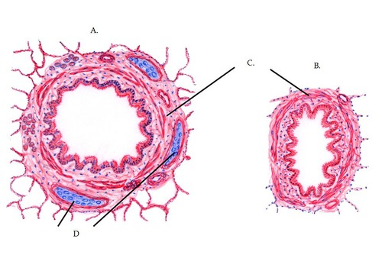
Bronchus and Bronchiole

Slide 9
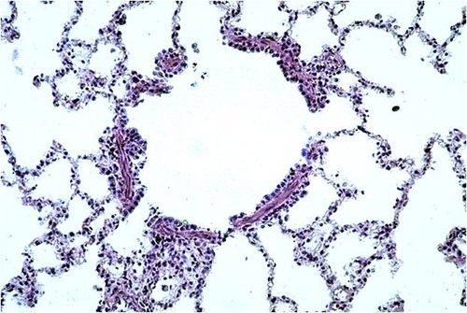
2-Respiratory bronchioles:
-are lined by simple cuboidal cells, some of them are ciliated and the wall is interrupted by simple squamous epithelium (the wall of alveoli).
-the muscle and elastic fiber are found.

Slide 10
•Alveolar duct:
Has thin discontinuous lined by simple squamous epithelium supported by fibro elastic connective tissue.
•Alveolar sacs:
Are formed the opening of several alveoli, attached to the ducts.
•Lung alveoli (pneumocytes):
200 million in a normal lung
Total area-75 square meters
Total capillary surface area available for exchange-125square meters
Are spongy and form the parenchyma of lung.
Sac like evagination present at the terminal end of the bronchial tree.

Slide 11
Alveoli are separated by Interalveolar septum lying between thin epithelial lining of two neighboring alveoli.
Interalveolar septum contains a network of capillaries supported by reticular and elastic fibers, occasionally fibroblasts, macrophages and mast cells.
Septum contains pores(ALVEOLAR PORES OF KOHN) help in passage of air from one alveolus to another, thus equalizing Pressure in the alveoli.
Elastic fibers-enable the alveoli to expand during inspiration and passively contract during expiration.
Reticular fibers support and prevent over distention of the alveoli.

Slide 12
_Cells in Alveoli:
Type I Pneumocytes
Type II Pneumocytes
Macrophages or Dust cells
-Alveolar Type I cells
They form about 45% of alveolar cells population, are lined by an thin simple squamous epithelium, their ends are connected by tight junction to prevent leakage of tissue fluid in to the alveolar lumen.
-Alveolar Type II cells
-They are roughly cuboidal with many microvilli on their free surface.

Slide 13
-synthesize and secret a surfactant, it reduces surface tension across the squamous epithelium of the alveoli in the lungs.
-prevent collapse of alveoli during expiration.
-regenerate themselves and replace the damaged type pneumocytes.
-Alveolar macrophages-dust cells-
usually free in the alveolar lumen, also in tissues between alveoli.
Derived from Monocytes and are part mononuclear phagocytic system.
Either seen in the septa or alveoli.

Slide 14
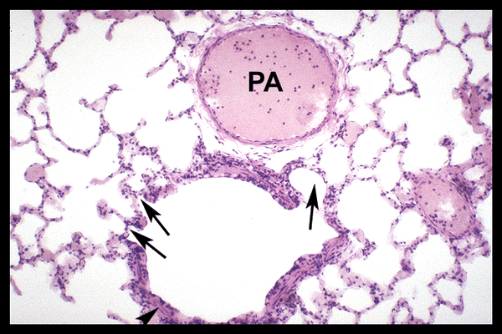
Alveoli
Respiratory bronchiole – cross section – H&E – 10x objective
alveolar wall
alveolar sac

Slide 15
Cytoplasm contains phagocytosed inhaled carbon and dust particles.
Inhaled carbon and dust particles are passed on to them from pneumocyte I through pinocytic vesicles.
Migrate from septum to alveolar surface and are carried to the pharynx through sputum.
Main function is to clean the alveoli of invading microorganisms and inhaled particulate matter by phagocytosis.

